Slide 1
Connect with Microsoft’s Financial Consumers
Speaker Name
Title
Microsoft Advertising

Slide 2
Industry Impacts
Notes:
Notes: We’ve set the stage, and delivered the warm fuzzies. Now we need to prove to them that our audience (our site visitors) align with their target market (their customers). This part of the story will tell the story of “a day in the life” of an MSN Money user, and will focus on MSN Money and the Finserv Audience, but will also begin to introduce cross sell opportunities on other publishers (skype, xbox, Bing Finance app, etc). Sprinkle in our Microsoft Customer First message, and it will lead right into the MSN Money pitch of the story.
In a phrase: “We understand our visitors, and they align with your customer profile. Plus we have some great growth opportunities if you are looking to expand your buy beyond Money.”

Slide 3
Shifting Market Environment
Channel
Issues
Branch vs. Digital
Consumer Issues
Lower trust
Word-of-mouth confusion
Differentiate
or Die
The demand for innovation
Regulation
Pressures
Data-Powered Marketing Opportunities
Brand Protection Concerns
Increased
ROI Focus
Notes:
“There is constant flux in the Financial Services industry, and these topics touch on some of the key factors in the environment that we are trying to solve for. Every day you are faced with new, complex challenges – and we understand what those are. By staying close to your industry, we understand your challenges and pain points, which helps guide us to build solutions to address them. We develop our product strategy and our roadmap based on these challenges in the market.”
Talking Points
Our Financial Services clients tell us these are the industry, market and consumer trends most on their minds:
Channel Issues: Branch vs. Digital – Ability to create detailed, differentiated marketing messaging by channel creates opportunities but adds complexity
Data-Powered Marketing Opportunities – how to make the most of in-house, third-party and partner data
Brand Protection Concerns – the online marketing environment brings
Consumer Issues: Lower Trust, Word-of-Mouth, Confusion
Regulation Pressures
‘Differentiate or Die’ – Demand for Innovation
Increased ROI Focus
Which trends resonate most for your business?
What would you add?
June, 2013 IPSOS Acct team feedback--
Broadly, what business problems do you think financial clients are facing most in their respective categories? (top of mind for you, first financial products / categories that come to mind.)
Gaining and retaining new customers (younger, female, highly active, unique users)
Scale vs personalization (privacy)
Customer trust
Connect w consumers across all media touchpoints / digital channels / cross-screen
Change perceptions
Standing out from competition - creating experiences
Regulatory issues Measure effectiveness of client campaigns / ROI / active investments

Slide 4



Your hot topics are our deliverables
The industry may be complex, but we have answers to your needs.
Data and Insights
Drive Brand Action
Cross-Channel
Builds Reach
Making Social Impactful
Notes:
“Not only do we understand your challenges in the industry, but we know what matters to YOU, and that is how we build our product strategy. We’ve heard these three things matter most…”
“Three of the key topics that frequently arise are: Data/insights, cross channel, and social. Not only are these hot topics, but it is critical to get these three items right to success in your competitive landscape. The MSN ad product, and the all-up MSA offering, addresses these topics and we’re building solutions to meet your needs. Let’s dive right into them.”

Slide 5

Hot Topic: Data and Insights Drive Brand Action
Targeting improves
Storytelling
New standards for measurement and optimization
80% of FinServ marketers
struggle with, and are using new
ways to measure ROI³
38%
35%
‘Big Data’ improves marketing
91% hit target audience with
data and targeting⁴
87% of Marketers will pay premium
for targeted content⁵
of financial service firms increased use of targeting YOY.¹
increase in the use of third-party targeting data in mobile ads it served for the finance vertical.²
1. Data is from the January 2012 The Financial Brand "2012 Bank & Credit Union Marketing Survey.“; 2. Jumptap, “Simple Targeting and Audience Trends (STAT),” Aug 7, 2012; 3. “State of bank and credit union Marketing, 2013” by Aite Group and The Financial Brand, February,12 2013; 4/5. Martini Media’s survey conducted with Grammercy Institute, March 2013.
Notes:
New Standards for Measurement and Optimization
Online GRPs
Closed-loop reporting
Automated insights
Aided Brand Awareness
Message Association
Brand Favorability
Intent to Buy
‘Big Data’ improves marketing
Drive to harness enterprise data
Offline data moves online

Slide 6
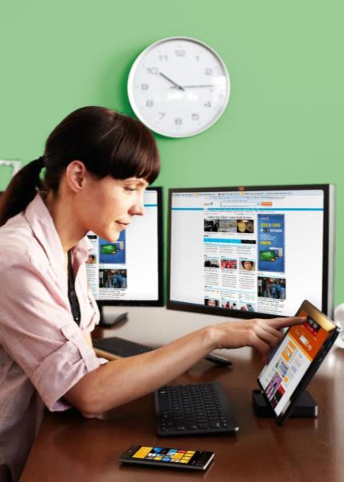
Hot Topic: Cross Screen Builds Reach
Expanding platform
and media options:
Consumer expectations
in motion
Consumers expect a seamless brand experience across platforms throughout their consumer journey.
61%
Now bank online¹
Increased channel
and platform sensitivity
80%
of financial consumers now have smartphone penetration²
    Financial marketers seek
    cross-screen efficiencies.
39%
Growth projected in mobile due to high ownership of tablets³
1. Pew Internet and American Life Project, August 7, 2013; 2. Millennial Media and comScore Inc., “Mobile Intel Series: Finance”; May 9, 2012; 3. Forrester Research Interactive Marketing Forecast By Industry, 2011 to 2016 (US)
Notes:
Select Methods Used by US Internet Users to Access Banking Information, March 2013
74% on a computer (e.g. desktop, laptop)
65% in-person (e.g., with a teller, at an ATM)
34% on my smartphone, through my bank’s mobile app
26% on the phone (e.g., calling customer service hotline)
23% on my smartphone’s mobile web browser
Source: via eMarketer - Yodlee survey conducted by Harris Interactive as cited in press release, April 30, 2013

Slide 7

Hot Topic: Making Social Impactful
Evolving use of social
Going Beyond the ‘Like’
Marketers realize more benefit in using Social Media for client communication and less for lead generation than in recent years.
There is a need to move beyond “likes” as an end measurement and incorporate what people care about to deliver true value.
Social Trend Tracking Technology monitors tweets, likes, and searches to know what users are gravitating to, in real time, enabling you to activate your consumer base with relevant content.
Changing the conversation
    ‘Social’ has historically been seen
    as the ability to drive likes, tweets, and shares.
    Now it is driving strategy and execution plans

Slide 8
Investing in the
Financial Services Consumer
Notes:
Notes: We’ve set the stage, and delivered the warm fuzzies. Now we need to prove to them that our audience (our site visitors) align with their target market (their customers). This part of the story will tell the story of “a day in the life” of an MSN Money user, and will focus on MSN Money and the Finserv Audience, but will also begin to introduce cross sell opportunities on other publishers (skype, xbox, Bing Finance app, etc). Sprinkle in our Microsoft Customer First message, and it will lead right into the MSN Money pitch of the story.
In a phrase: “We understand our visitors, and they align with your customer profile. Plus we have some great growth opportunities if you are looking to expand your buy beyond Money.”

Slide 9


Finance Consumers across Microsoft
Reach
PV/
Queries
Minutes Viewed
Finance App
Reach
PV/
Queries
Minutes Viewed
1
16.6M
269M
210M
1.5M
8.1M
18.5M
2
Target Audience
81%
53%
47%
43%
43%
Target Audience
62%
32%
68%
38%
42%
Are 35+
Are Women
Are
Men
$75k+
HHI
College educated
Are 35+
Are Women
Are
Men
$75k+
HHI
College educated
Mobile
MSN and Bing Apps
Reach
PV/
Queries
Minutes Viewed
Reach
PV/Queries
3
103.2M
3,506M
1,595M
2.3M
3.6M
2
69%
52%
48%
47%
47%
Target Audience
Are 35+
Are Women
Are
Men
$75k+
HHI
College educated
Source: 1. comScore May 2013; 2. Microsoft Internal Data, H1 2013; 3. comScore May 2013

Slide 10


Our ads drive brand and site engagement
Lift in number of users engaging in brand behavior by audience
Banking
Auto Insurance
Investing & Brokerage
33%
54%
97%
Lift in number of users engaging in brand behavior by Channel
60% lift
in the number of users engaging in brand-related activity after ad exposure
59%
54%
43%
22%
Video
Source: Microsoft Advertising Internal Reports for US, based on a sample set of Financial Services advertisers with campaigns on 11/01/2012 to 04/28/2013. Control group: 1) Not exposed 2) Visit the ads location during campaign period 3) Meet delivery conditions 4) Have similar brand behaviors as exposed before campaign; Brand behaviors included branded search and visits to advertiser sites

Slide 11
Our visitors are truly unique
15.4M not on CNBC
MSN Money has
a huge reach
15.3M not on Forbes
15.2M not on CNN Money
16.4M UUs
15.2M not on Wall Street Journal
15M not on Bloomberg
14.3M not on AOL Money & Finance
13.2M not on Yahoo! Finance
Source: comScore Audience Duplication, May 2013

Slide 12
Our visitors are your target audience
16M on MSN Money ¹
27.7M Auto Insurance Researchers ²
78%
29.9M Banking Services Researchers ³
of the Financial Services audience online visit Microsoft Sites
5M Active Traders ⁴
6.3M New Traders ⁵
42M Long Term Investors & Retirement Seekers ⁶
Source: 1) comScore Key Measures June 2013; 2) comScore Plan Metrix May 2013 (Auto Insurance Researcher audience defined as users who have searched for auto insurance online in the last 6 months); 3) comScore Plan Metrix May 2013 (Banking Services Researcher audience defined as users who have searched online for high yield saving accounts/CDs/checking account/initial/second home mortgages/savings account/credit cards in the last 6 mo); 4) comScore Plan Metrix May 2013 (Active Traders defined as users with portfolio value>$500K or >50 brokerage transactions online); 5) comScore Plan Metrix May 2013 (New Traders defined as users who searched online for Money Market accounts, brokerage accounts, IRA or 401K in the last 6 months); 6) comScore Plan Metrix May 2013 (Long Term & Retirement planners defined as users who have IRA or 401K accounts)

Slide 13

Amplify your performance with Targeting
Bing Remessaging targets those searching for you on Bing with display advertising
249%
We offer over 150 behavioral segments,
and 17 of them are Financial Services segments
liAverage ft in CTR for
Active Traders¹
Source: 1. comScore MediaMetrix, March 2013
Notes:
*Attn AE – in the purple box on this slide, please paste in the appropriate CTR number for your audience segment from the list below
Financial Services – Avg. lift in CTR
Active Traders: 249%
New Traders: 219%
Auto Insurance Researchers: 138%
Expert Traders: 114%
Personal Investors: 109%
Home Buyers: 99%
Long Term Investors and Retirement Planners: 96%

Slide 14
Meet our Financial Services Audience
58%
Between the ages
of 25-54
51%
Male
31%
Have a $100K+
annual HHI
49%
Have applied online for financial products like High Yield Savings Accounts, Money Market Accounts or IRA Accounts in the last 6 months
35%
More likely than the general audience to have a stock portfolio of $1M or more
23%
More likely than the general audience to use their credit card points to purchase a new car
Source: comScore Plan Metrix Measures May 2013

Slide 15
Financial Consumers are connected to Microsoft publishers
Our Consumer First approach delivers an experience consumers love, and our FY14 strategy will engage them even more

Slide 16

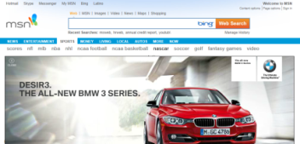

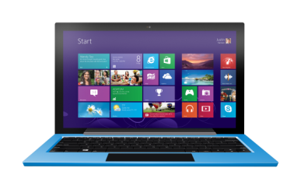


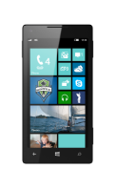
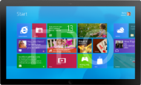
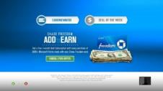




Microsoft engages consumers
Connection
Innovation
Intention
Intention
Seamless experience across Windows 8 ecosystem
Award winning, engaging ad formats like Polymorphic
Insight
driven
targeting
We enable delightful advertising experiences on devices and services consumers love
Offline data is
now online
with IXI, Experian
and other partners
Audience extension
New opt-out control
Custom and Standard Targeting solutions that work in concert with brand sponsorships
Connection
Multiscreen campaigns across mobile, TV, PC, tablet, AiA
Customize truly creative experiences such as Custom Sponsorships
Content and
inventory you
can trust
Leading and engaging rich media (Rising Stars)
New partnerships deliver premium content our users crave
Innovation
Global Scale
Global Scale
Brad-safe environments
Microsoft sites have 870MM UUs, or 56%, of the internet market worldwide¹.
Microsoft Sites ranked second only to Google Sites who reach over 1.1B UUs, and ahead of Facebook, who ranked third reaching over 826MM UUs¹
Relevant experiences that people value and deepen brand engagement
Meet your brand needs, while delivering on our customer first promise
Custom brand solutions that are inviting, not interruptive
Source: comScore MediaMetrix, Key Measures, JULY 2013
Notes:
Script: “Microsoft has a unique portfolio for you (our advertisers) to engage with customers, and our people-first approach has major benefits that align with your needs. Microsoft sites have 870MM UVs, or 57%, of the internet market worldwide. Microsoft Sites ranked second only to Google Sites who reach over 1.1B UVs, and ahead of Facebook, who ranked third reaching over 826MM Uvs. Our three key pillars of focus are Intention, Connection, and Innovation.
Intention – With our people-first approach, we start with the consumer needs rather than focusing our energy on “grabbing the consumers’ attention” to get a click. Not only are we focusing on being relevant to our users, but we want the intention to be focused fully on the consumer, so they have the best experience possible on the web.
Connection – Our mission is to enable advertising experiences that customers want, on devices they love. The experiential approach will enable marketers to reach consumers wherever they are with beautiful and useful experiences. We want to build REAL experiences, that connect with our consumers in a truly meaningful way.
Innovation – We reach consumers in a broader set of interactions that meet their fundamental needs than anyone else in the industry. In addition, our ad experiences are built to make sense to users– both from what they are seeing to why they are seeing it.
With these key pillars in place, we believe we have what it takes to go beyond the basics, and deliver an engaging and thoughtful experience to users, and better yet, turn them into YOUR customers.

Slide 17




Financial consumers interact with our ecosystem
These publishers reach your target market:

Slide 18






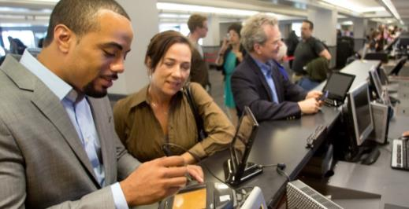
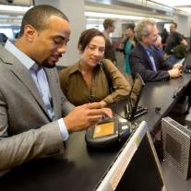








Passive
Active
Open to possibility
Decision to Change
Experiencing
Decision to buy/change
Evaluating
Shopping
Experiencing
Experiencing
Decision
to buy
Experiencing
Open to possibility
Decision
to buy
Evaluating
Decision
to buy
Experiencing
Decision to change
Experiencing
Decision to change
Decision
to buy
Experiencing
Experiencing
Evaluating
Shopping
Decision
to buy
Decision
to buy
Evaluating
Evaluating
Decision
to buy
Evaluating
Shopping
Shopping
Experiencing
Experiencing
Decision to change
Experiencing
Decision to change
Experiencing
Open to possibility
Experiencing
Open to possibility
Decision to change
Decision to change
Decision to change
Experiencing
Open to possibility
Experiencing
Evaluating
Shopping
Experiencing
Open to possibility
Shopping
Open to possibility
Open to possibility
Evaluating
Shopping
Open to possibility
Experiencing
Shopping
Figuring out what needs to be done
Lessons absorbed from your past
Putting in place features/products
to help reach the goal
Passive initial decision to
do something about your goal
Passive ownership of product/plan
A realization that something needs to change
Actively keeping an eye on things
Consumers need help imagining what success
looks like
General financial and market news can be the only source of information consumers pay attention to.
Access to objective and personal sources of feedback and information are needed. Forums and user reviews can help narrow down choices.
MSA Solution:
Skype can help connect to those closest to her in the crucial evaluation stage.
Bing links to consumer and expert reviews and articles
and advice are key.
MSA Solution:
People-powered stories through advertorials or videos on MSN, MSN Money, and Xbox provide ideas on how
to accomplish a goal and
spur action.
Consumers are determined
to start in a better place. Access to content such as “Top Banks”, e.g. can set
a more organized
approach to evaluating.
MSA Solution:
Trending articles on Bing on money and the financial industry can break through the fog.
MSA Solution:
Rankings and comparisons through Bing Finance App
and MSN Money can provide
a place to start.
Validation through media and word of mouth can spur confidence and empowerment to tackle the next goal.
MSA Solution:
Advertising and content through other lifestyle channels like… to stay top of mind. Positive news and advertorials on brands as well as links to social content on Bing can help validate
their choices.
Quick bites of information on
easy to understand product benefits
are needed
Deeper information and access to experts are welcome.
Empower consumers with
links through search to
validate choices.
MSA Solution:
Content and videos on more sophisticated products through Bing Finance App MSN Money and help consumers feel more in control and more informed.
MSA Solution:
Links through Bing for easy comparison of rates and benefits can help reassure and provide light information. Contextual ads linked to sponsored or advertorial content provide quick triggers.
Notes:
We challenged ourselves to revisit the traditional sales funnel and explore whether we could identify a more consumer-centric model, where consumer behavior and need-states drive opportunities & solutions.
That led us to re-envisioning the path to purchase as a dynamic journey, defined by the needs and motivations of the consumer. Some consumers may move smoothly through the stages if marketers do a good job of meeting their needs but many will go back & forth between stages and some get stuck if their needs aren’t met.
Digital channels have potential to guide consumers smoothly through the decision journey by meeting their needs from the very beginning of their journey through to the purchase point & beyond.
The path to financial decision making is complex for consumers. Consumer often feel a lot of confusion and helplessness in early stages and often get stuck with plans/products that don’t work for them, often causing inertia and a passive approach to buying/owning financial products.
Let’s look at the high-level journey for financial goals:
Open to possibility: LAYING TRACKS
Consumers’ experiences often set the stage for how they approach a financial goal. Lessons learned from parents/people influencers, earlier experiences and their own personalities can define how actively or passively approach their goal.
NEED: Consumers need help imagining what success looks like.
SOLUTIONS: Videos and stories/articles centered on real people can help connect on a personal level and spur consumers to make a plan.
Decision to change (EARLY STAGE): GETTING ON BOARD
If a consumer starts the journey from an earlier life stage, or doesn’t feel empowered with enough information, he/she will make a passive decision to set a plan. Often the products/plans are those easiest to obtain, requiring little to no research and virtually no active shopping phase. Products are often those recommended by a strong influencer like a parent, or those that can be extended from current products already owned (i.e. from current bank or institution).
NEED: Light research and access to simple product comparisons.
SOLUTION: Links to easy comparison of rates and benefits can help reassure and provide (not too much) information. Use easy messaging in advertising or connect to advertorials and stories explaining basic terms.
Experiencing (Early Stage): CHUGGING ALONG
The “set it and forget it stage”. Consumers know very little about their plans and often let it run in the background. There is a vague dissatisfaction that they need to do more, but inertia and feeling that a change will be more trouble that it’s worth can get consumers stuck and dissatisfied.
NEED: A jolt can move the consumer to a more active stage. Negative news can accelerate feelings of dissatisfaction.
SOLUTION: News articles through Bing and MSN portals can surface any system-wide issues a consumer needs to keep track of.
Decision to Buy/Change (Active): HITTING A CURVE
The consumers experiences a life change or an external shock has brought on the realization that the passive approach is not working.
NEED: Consumers are determined to start in a better place. Access to content such as “Top Banks” or “Top Accounts for College Savings” can set a more organized approach to evaluating and help set the stage so the consumer feels empowered in their decision.
SOLUTION: Advertorial content on account and feature rankings through MSN Money and Bing Finance App. Messaging in ads that hits at specific ways a consumer can achieve a goal can draw the eye.
Evaluating: TAKING CONTROL
Consumers are actively evaluating the right approach, the right companies and the right products.
NEED: Access to varied sources of information is key. Personal validation through those closest can help tip consumers towards specific products/brands.
SOLUTION: Skype can help connect to those closest to her in the crucial evaluation stage.
Shopping: BACK ON TRACK
The consumer is armed with the facts and is actively choosing specific plans/products/brands.
NEED: Deep product information and understanding of full financial picture.
SOLUTION: Articles and content that dives more deeply into more sophisticated products. Videos and access to experts can also help consumers feel empowered in their choices. Search can connect consumers to various sources including Social information on Bing.
Experiencing: MAINTENANCE
The goal is within reach and consumers feel good about their choices. However, they are looking for constant reassurance that they are doing well.
NEED: Continuous feedback from brands, personal contacts, media that they are on the right track.
SOLUTION: Stay on the consumers’ radar through brand messaging that provides personal connection. Articles and advertorials focusing on brands and how they help consumers can provide external validation consumers are looking for.

Slide 19






Our Financial Services audience spends time on Microsoft properties throughout the day
Morning
5-9am
Morning
5-9am
Mid-Day
9am-1pm
Mid-Day
9am-1pm
Afternoon
1-5pm
Afternoon
1-5pm
Evening
5-8pm
Evening
5-8pm
Source: Microsoft Advertising Internal Reports for US, May 2013

Slide 20
MSN Money is your match
Notes:
Notes: We’ve set the stage, and delivered the warm fuzzies. Now we need to prove to them that our audience (our site visitors) align with their target market (their customers). This part of the story will tell the story of “a day in the life” of an MSN Money user, and will focus on MSN Money and the Finserv Audience, but will also begin to introduce cross sell opportunities on other publishers (skype, xbox, Bing Finance app, etc). Sprinkle in our Microsoft Customer First message, and it will lead right into the MSN Money pitch of the story.
In a phrase: “We understand our visitors, and they align with your customer profile. Plus we have some great growth opportunities if you are looking to expand your buy beyond Money.”

Slide 21

Why MSN Money?
Growing, engaged audience
Delivering valuable
ad experiences
Ensure the best performance
from every media dollar
Innovating for the
future of MSN Money

Slide 22
Our audience is affluent and financially savvy
63%
Between the
ages of 35-64
53%
Male
36%
Have a $100K+ annual HHI
75%
More likely than the general audience to have searched for info online for money market account in the last 6 months
38%
More likely than the general audience to check stock quotes online once a day
17%
More likely than the general audience to very likely purchase a new residence in the next 6 months
omScore Plan Metrix Measures May 2013

Slide 23
We attract engaged users
In fact, we do it better than our competition
277M
Total Pages Viewed
(higher than CNBC, AOL, Bloomberg, WSJ, Forbes and CNBC)
2.9M
Average Daily Visitors
(higher than AOL, Bloomberg, WSJ, CNBC, CNN Money and Forbes)
203M
Total Minutes
(higher than AOL, CNN Money, WSJ and Forbes)
5.2
Average Usage Days per Visitor
(higher than Yahoo, AOL, Forbes, Bloomberg, WSJ, CNN Money and CNBC)
1.5B
Total Visits
(higher than AOL, Bloomberg, WSJ, CNBC, CNN Money and Forbes)
6.4
Average Visits
per Visitor
(higher than CNBC, WSJ, Bloomberg, AOL, CNN Money and Forbes)
Source: comScore Key Measures May 2013

Slide 24
We continue to grow
 | 2012 | 2013 | growth
Unique Users | 14.8M | 16.4M | 11%
Total Pages Viewed | 240M | 277M | 15%
Average Pages per Usage Day | 2.7 | 3.2 | 19%
Average Pages per Visitor | 16 | 17 | 6%
Average Pages per Visit | 2.2M | 2.6M | 18%
17M Users
The web’s second-largest finance site, up 13% since 2011.
9%
YoY growth in
first four months
of 2013
Source: comScore Key Measures Media Trend, June 2013 vs. June 2012;

Slide 25



MSN Money delivers
Our key pillars are driving MSN Money onwards and upwards
Intention
Connection
Innovation
Notes:
“Not only do we understand your challenges in the industry, but we know what matters to YOU, and that is how we build our product strategy. We’ve heard these three things matter most…”
“Three of the key topics that frequently arise are: Data/insights, cross channel, and social. Not only are these hot topics, but it is critical to get these three items right to success in your competitive landscape. The MSN ad product, and the all-up MSA offering, addresses these topics and we’re building solutions to meet your needs. Let’s dive right into them.”

Slide 26



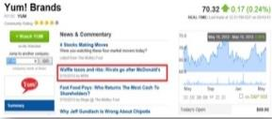

Intention
Original, syndicated content
Trusted voices on Investing
Morningstar partnership delivers more comprehensive securities data
Upgraded stock charts with industry-leading features
Trusted financial experts include: Jim Cramer, Liz Weston, Jim Jubak and Anthony Mirhaydari.
Top content curation: Wall Street Journal, Bloomberg, CNBC.com, Forbes, Reuters, TheStreet.com, The Fiscal Times, Bankrate.com and InvestorPlace.com
Staying on top
Connect to users like never before with alerts, broader social outreach and an increased emphasis on LinkedIn

Slide 27


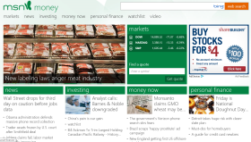
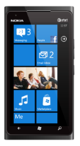
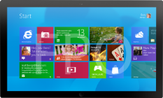
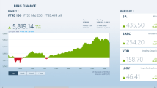

Connection
Cross-Screen
Getting Personal
Consistent view across PC,
tablet and mobile
Robust Personal Finance section
Retirement-package options
Sponsorable tools
Original video opportunities
Expanded tax-season opportunities
Staying on top
Easier to post and share content
Algorithm-driven social trending technology syncs MSN Money content with user interests
Content now reaches more users via other sites’ quote pages and social distribution

Slide 28

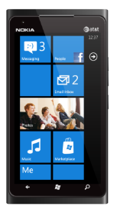
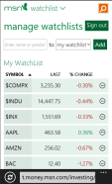
Innovation
Trending
Mobility
Unique Social Trending technology identifies the topics users will find most engaging on social media platforms. This, partnered with our editors, deliver premium curation to suggest topics ensuring MSN Money has some of the most shareable, buzz-worthy coverage on Facebook, Twitter and other social networks.
Users can now use our stock watchlist on PCs, tablets and phones.
New Products
Small business section launching in September
Daily original market video
Infographics optimized for social sharing
New sponsorable custom templates
Ads in Apps

Slide 29
MSN Money returns with strong lineup
MSN Money Sponsorships
Trusted consumer tools
Small Business Smarts
Wealth Guide
Broker Center
Top Stocks
Investor Pro
Quote Tiles
Boost Home Value
Luxury Spending
Charts
Buyer’s Guide
Tech Spending
Tax Center
Tech Biz
DIY Improvement & Repair
Retirement Tools
Business Travel Guide
Senior Living at Home
Notes:
Small Business Smarts
Whether you’re starting a business or growing your business, this guide keeps you informed of best practices, inspiring success stories, and practical how-tos.
Tools included: What are my new business startup costs, What is the value of my business?, What are my business financial ratios?
Top Stocks
Top Stocks provides everything you need for making great picks for your stock portfolio: expert advice to find the best investments for you, latest news, and quote and research tools.
Boost Home Value
Find out which variables impact the value of your property -- from remodeling to neighborhoods to nearby foreclosures.
Buyer’s Guide
Learn about every aspect of the homebuying process: From budgeting to browsing homes to closing and taking possession.
Tech Biz
Start investing in technology companies with help from financial writers and experts who know the industry best. Learn what to look for in a technology company to make the right investment decisions.
Business Travel Guide
How to save money and find the best deals on business travel, including airfare, hotels, meals and other expenses encountered by today’s road warriors.
Wealth Guide
Secrets to increasing your wealth from those who know.
Investor Pro
Learn advanced techniques for picking and trading equities and building your portfolio, including screening, charting, technical analysis. And master quick-twitch strategies for trading on world and market news.
Luxury Spending
Secrets to making, keeping, and living well on your hard-earned wealth.
Tech Spending
Is the latest and greatest gadget worth it? Does is make sense to upgrade? A guide to help you spend your tech dollars wisely.
DIY Improvement & Repair
Advice for all home projects, big and small. From whole-house remodels and how to work with home improvement professionals to applying new weatherstripping for the winter.
Senior Living at Home
A guide to help you downsize your home and mortgage, find retirement communities, and learn about DIY home products for seniors.

Slide 30
Introducing Bing Finance

Slide 31
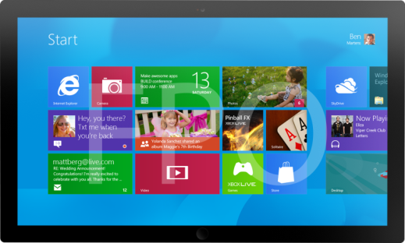
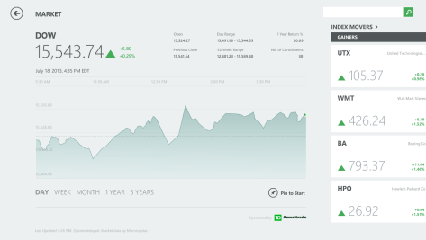
Coming Soon: Quote Tile Sponsorship
Keep your brand top
of mind
Contextually relevant audience
Drive engagement with premium and exclusive space
Be seen first
Located after first swipe on the app
Every consumer opening the app
sees the placement
Bundle it
Bundle with your MSN Money buy, and go beyond the desktop
Flexible sponsorship availability

Slide 32

© 2013 Microsoft Corporation. All rights reserved. Microsoft, Windows, Windows Vista and other product names are or may be registered trademarks and/or trademarks in the U.S. and/or other countries.
The information herein is for informational purposes only and represents the current view of Microsoft Corporation as of the date of this presentation. Because Microsoft must respond to changing market conditions, it should not be interpreted to be a commitment on the part of Microsoft, and Microsoft cannot guarantee the accuracy of any information provided after the date of this presentation. MICROSOFT MAKES NO WARRANTIES, EXPRESS, IMPLIED OR STATUTORY, AS TO THE INFORMATION IN THIS PRESENTATION.

Slide 33
APPENDIX
Notes:
Intro slide to the Industry and Hot Topics discussion. The key focus here is to value sell that we understand the industry and their hot topics and pain points. Their challenges are our action items; not just in the advertising sense, but delivering a great experience to customers that drives engagement, and thus an ideal platform to get our advertisers in front of their target segment (which is our audience).
In a phrase “We understand your business and its challenges, and we’re here to help. We deliver.”

Slide 34
Slide Library Table of Contents
Cross-Channel Opportunities
Cross-Publisher Opportunities
Skype
Xbox
Bing Finance App
Mobile Inventory
Custom Ad Opportunities on Windows 8
Targeting
Sub-verticals
Notes:
Intro slide to the Industry and Hot Topics discussion. The key focus here is to value sell that we understand the industry and their hot topics and pain points. Their challenges are our action items; not just in the advertising sense, but delivering a great experience to customers that drives engagement, and thus an ideal platform to get our advertisers in front of their target segment (which is our audience).
In a phrase “We understand your business and its challenges, and we’re here to help. We deliver.”

Slide 35
Cross-Channel Opportunities

Slide 36

Find Financial Services researchers on Microsoft sites
Source: comScore Plan metrix report comscore, May 2013 (Financial Services Researcher audience defined as those who have searched for a financial product online in the last 6 months); Xbox data from comScore Digital Analytix

Slide 37
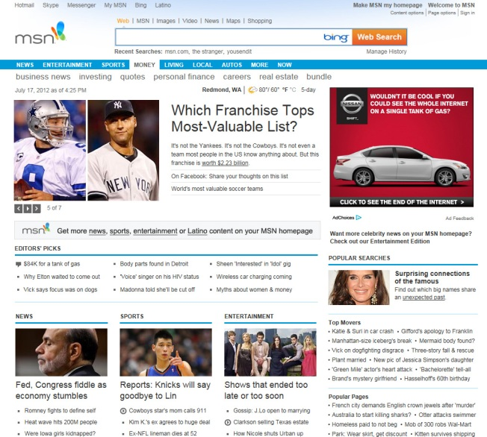
Homepage Sponsorship
300x600, 300x250 & non-UI float
or UI expand
In banner video (no float)
Rich Media Opportunities
Standard ad, Standard Rich Media,
and Premium Rich Media Takeovers
Notes:
MSN HP Audience Metrics:
2.8M used the internet to search for or acquire a loan in the past 6 months
26% have an account with a brokerage firm
46% used their credit card in the last 30 days
26% have an account with a brokerage firm
24% have online access to their brokerage firm
2.8 Million people used the internet to search for or acquire any type of loan (including an initial or second home mortgage) in the past 6 months
3.7% have shopped for or applied for a money market account in the past 6 months
3% more likely to have searched the internet for information on personal loans in the past 6 months*
*than the average internet user
Source: comScore Plan Metrix, June 2012
Rich Media Performance Metrics – Financial Services
300x600 CTR: .12% ITR: .29% Avg. Engagement Time (Seconds): 78 % of users that watched at least 75% of video within Ad Unit: 35.06%
300x250 + Non-UI Float CTR: .11% ITR: .19% Avg. Engagement Time (Seconds): 4 % of users that watched at least 75% of video within Ad Unit: 51.60%
300x250 + UI Expand CTR: .09% ITR: .16% Avg. Engagement Time (Seconds): 8 % of users that watched at least 75% of video within Ad Unit: 45.24%
In-Banner Video (no Float) CTR: .10% ITR: .13% Avg. Engagement Time (Seconds): 26 % of users that watched at least 75% of video within Ad Unit: 70.03%
All Rich Media Types CTR: .10% ITR: .18% Avg. Engagement Time (Seconds): 18 % of users that watched at least 75% of video within Ad Unit: 52.79%

Slide 38
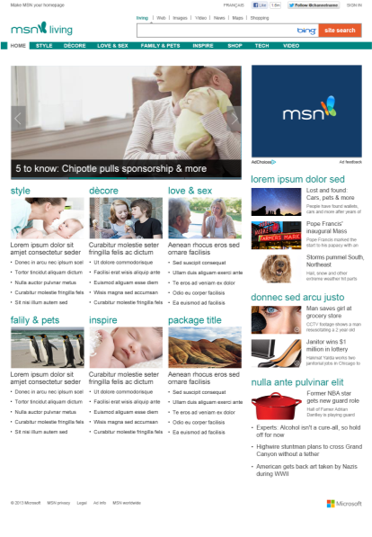
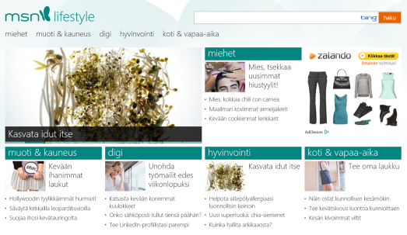
Impression Media
300x250, 300x600
Standard rich media ad offerings across content
sections on the MSN Network
Sponsorship Media
Existing site sections and custom opportunities
Rich Media Opportunities
Standard ad, Standard Rich Media,
and Premium Rich Media Takeovers

Slide 39
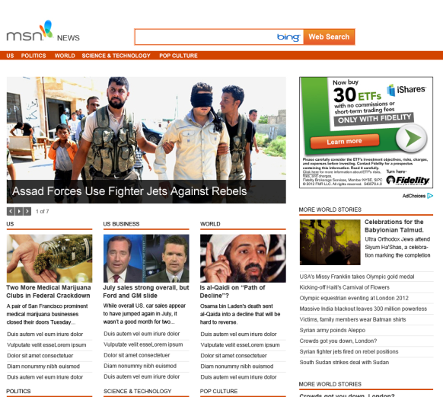
Impression Media
300x250
300x600
Sponsorship Media
Existing site sections and custom opportunities
Rich Media Opportunities
Standard ad, Standard Rich Media,
and Premium Rich Media Takeovers

Slide 40

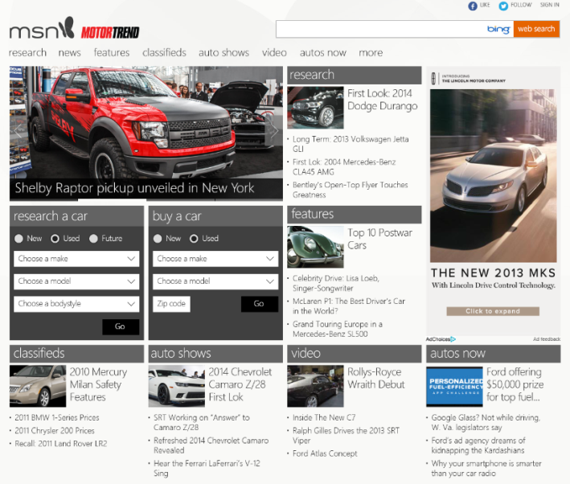
New site launching in Jan 2014
Merging the best of MSN Autos and Motortrend.com
94% is an unduplicated audience (7.9M Uus)
Will deliver a best-in-class autos experience for shoppers, enthusiasts, and influencers
New Social Tools
Surface trending auto topics and allow for sharing, complementing Motor Trend’s existing social media platforms
Advertising Opportunities
Integrated Shopping Tool Module
Scroll Initiated 300x250
300x600

Slide 41

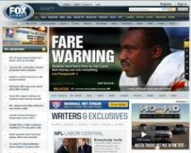
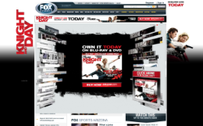
Impression Media
Standard Offerings by sport
Editorial Sponsorships
By event, sport season, and site selections
Rich Media Takeovers
Site wide or sport section one-day takeovers
Notes:
52% are college graduates/post graduates
64% are male
60% are 25-54
87% have purchased online in the last 6 months
34 Million UUs
25M UUs not on ESPN
23M Uus not on Yahoo! Sports

Slide 42
Publisher
Opportunities
Notes:
“Beyond MSN”
- cross pub story for applicable cross sell opps
“We’ve got huge growth opps for you!”

Slide 43
Advertising
on Skype

Slide 44
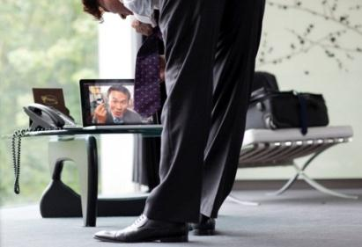


Advertisers like you sponsor human emotion through free Skype services
Skype-to-Skype voice
Skype-to-Skype video
Chat
Screen Sharing
Facebook Feed

Slide 45




Advertiser Value Proposition
US stats
Audience
40%
YoY Growth
47MM US Desktop
20MM US Mobile
35%
35%
30%
18-34
users
35-54
users
55+
users
Engagement
76%
Users connect with Family
1
Stay in-touch with friends/family
Celebrate an occasion
Plan an event
Average Skype Session
1 ad per page
Uncluttered exclusive environment
No Fold
2
65%
Top 3 Uses
>30Min
Users connect with Friends
3
Innovation
Conversations Ads:
Total differentiator, brands can be INSIDE
a Skype call
Mobile
Android & iPhone
Impact
17%
Lift in Likelihood to Recommend
15%
Lift in Brand Favorability
26%
Lift in intent to purchase
Notes:
Let’s get right to what brand advertisers care about for their media dollars – audience, engagement & innovation = brand impact.
Audience - LARGE, GROWING, DESIRABLE AUDIENCE
We’re currently at 330M monthly UU and the audience has undergone phenomenal growth since the app inception in 2003. We have almost a perfect split of males/females. And you can literally find every demographic on Skype – we’re not tied to just gamers or finserv for example – people are connecting and sharing whatever is important to them in the context of their life
Reach 330 million Monthly Unique Users across 73 countries.
The audience skews educated, affluent and social.
HIGHLY ENGAGED AUDIENCE
1/3 more than 2x per week
audience is using Skype every day to make a call and connect with family & friends
More than half is using Sky
The average Skype session is over 30 minutes³ and over half of the audience relies on Skype products twice a week or more⁴. Longer engagement times mean more time spent with your advertiser’s brand.
And the ads appear in an exclusive uncluttered environment – there are no ‘folds’ in Skype and only one ad will ever appear per page, giving your advertiser an exclusive, premium placement.
LEAN FORWARD ENGAGEMENT
The connections on Skype tend to be your closest family & friends. Skype users are in a special lean forward mindset when connecting with their closest family & friends. They are staying in touch, but also DOING things together – celebrating (singing happy birthday), playing games, learning guitar and planning weddings and trips – all offering advertisers rich messaging and creative opportunities. ³
Innovation:
Conversations Ads: Total differentiator, brands can be INSIDE a Skype call. In fact we have an entire ‘family’ on conversation ads across the desktop experience and Skype for Windows 8 – we have conversation ads inside IM, video calls and Audio calls.
Also, we know you want to offer your clients a great mobile solution. Skype already offers ads on the iphone, reaching 13M Americans every month. And in the next 90 days we’ll release ads on Android, reaching an additional 6M on-the-go mobile monthly users!
No other media vendor can claim this type of innovation!
Audience, Engagement and Innovation all drive BRAND IMPACT
Ad exposure on Skype drives considerable lifts across the purchase journey:
15% in brand favorability
17% in likelihood to recommend
20% in advertising recall
26% in intent to purchase⁴
GLOBAL DATA: 86 M users can be reached via iphone & android mobile offerings
Library of Customer Examples/STORYTELLING:
Audience:
Tech savvy – Samsung, Sony, HTC
Affluent –Wells Fargo, Amex, RBC, Barclay’s
Travel intenders – Emirates, Atlantis
Young, social – Universal
Families, moms – unilever
Engagement:
GVC - driving unique engagement on Skype: Olive garden & Citibank
Innovation:
Any Windows 8 Advertiser – Cadillac, Toyota, Citi
Brands that took advantage of rich media & video – Ford Kuga, Red Bull, Lipton, Kia
Experian: They are about to launch a ‘prop box’ creative which could be a perfect example of either innovation or engagement. We could even have strong screenshots. http://staging.joystickinteractive.com/package/1202/skype_experian These are just the mocks, but we should have it live by early march.

Slide 46

The Skype audience is a Financial Services audience
364% more likely to have searched for or applied for an IRA in the last 6 months*
64% more likely to have searched online for a High Yield Savings Account
22%
more likely to be the first among friends to use the latest financial information or products
    121% more likely to purchase a new residence in the next 6 months
Source: Compared to the average Internet user. comScore Plan Metrix, August 2012, [C] Skype Instant Messenger (App)*online or offline

Slide 47
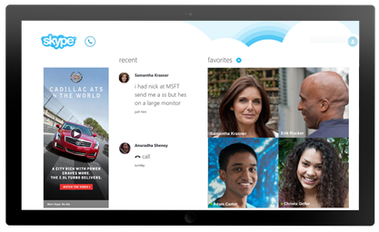
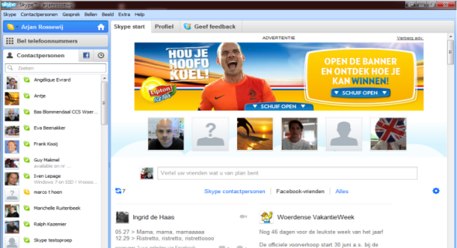
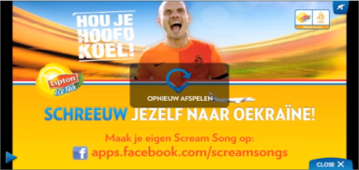
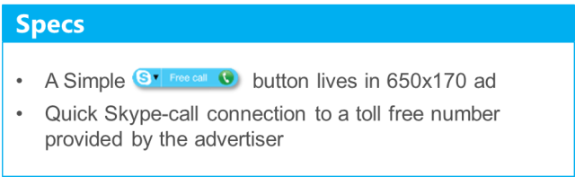
Growth Opportunities on Skype
Impression Media
Important Finserv days of the week
(i.e., Monday and Thursday for brokers)
Event days (games, Superbowl, tax season)
Aligned with takeovers on other MSA publishers
(attach to MSN or Xbox)
Editorial Sponsorships
Integrate button into Ads
Drive calls to your call center and drive adoption
Rich Media Takeovers
Buy desired target audience based on age, gender, and locations
100% of inventory is targetable down to the zip code

Slide 48

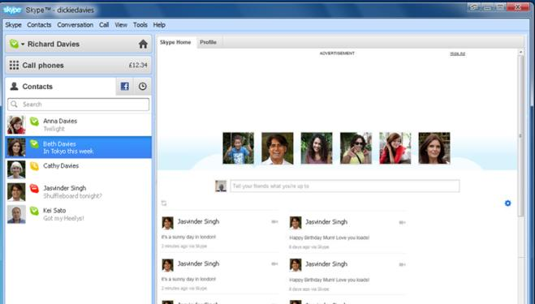

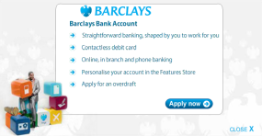
650x170 Skype Homepage takeover
Notes:
http://origin.demo.mediamind.com/productionservices/SkypeDemos/Finance/mediamindTestPage_Skype_Finance.html
Homepage Takeover for Barclays Bank

Slide 49





Partner across properties to reach key target audiences
Better Together
324M Homepage users
71% of Skype users are not on the MSN Homepage
311M
Skype users
Source: comScore Cross Visiting, April 2013.

Slide 50
Advertising
on Xbox

Slide 51
Xbox attracts your audience too
30%+
Total hours spent on Xbox LIVE has grown year over year
87
Average hours
per month spent on Xbox Live
25M
Xbox LIVE US subscribers
40M+
Active users
Xbox was the #1 selling console in 2011 and 2012
Xbox games, Xbox music and Xbox video are preinstalled on all windows 8 devices that provide advertisers a massive audience reach of Windows
46%
Explore Advertising content on
Xbox LIVE
2.7minutes
Average time spent in Branded Destination Experiences
Source: comScore Key Measures June 2013
Notes:
. • Over 40 Million active Xbox LIVE users • Total hours spent on Xbox LIVE has grown 30 percent year over year (includes online gaming and entertainment) • Continued global growth in Xbox 360 consoles and members worldwide • New entertainment experiences to make music, movies, sports, games and fitness even better on Xbox will continue to attract a variety of audiences • Xbox games, Xbox music and Xbox video are preinstalled on all windows 8 devices that provide advertisers a massive audience reach of Windows. • Many top OEMs have committed to pre- install the Microsoft Games Suite such as Solitaire and Mahjong on Windows 8, providing massive audience reach.

Slide 52
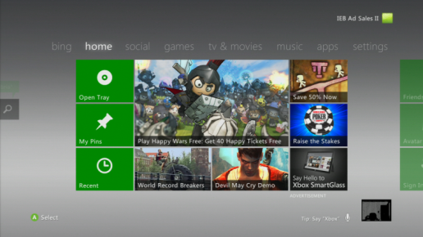
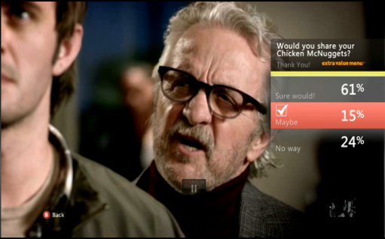
Growth opportunities on Xbox
Behavioral Targeting Ads
Targeted specifically to Finserv Audience
Ads that link to your website and/or drive sign ups
Branded Destination Experiences
drive engagement
Immersive branded microsites with innovative
content, just pay for the media spend
Send Instant Email, Develop Lead Generation Forms, Create Branded Theme Packs & Gamer Pics
NUads
Allows brands to engage with consumers using voice and gesture interactivity in ads
Currently offering Polling scenarios

Slide 53
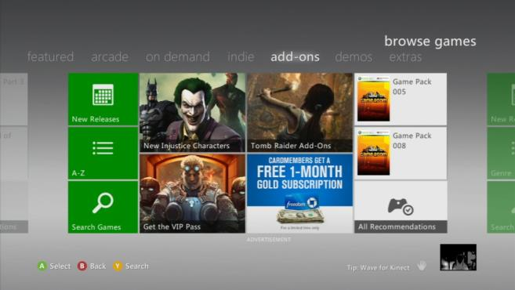
Chase Freedom – 263x197

Slide 54
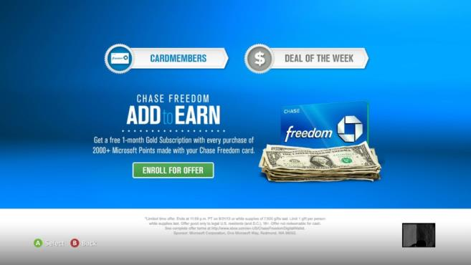
Chase Freedom – BDE Landing Page

Slide 55
Advertising
on Bing

Slide 56

Bing Apps
Pre-loaded on the Main Screen Windows 8 means large reach
Large, integrated exclusive formats perform well above industry standards
Reach consumers on the main screen of Windows 8 with contextually relevant apps.
Visually beautiful,
easy to use apps

Slide 57
Coming Soon: Quote Tile Sponsorship
Keep your brand top
of mind
Contextually relevant audience
Drive engagement with premium and exclusive space
Be seen first
Located after first swipe on the app
Every consumer opening the app
sees the placement
Bundle it
Flexible sponsorship availability
Bundle with your MSN Money buy

Slide 58

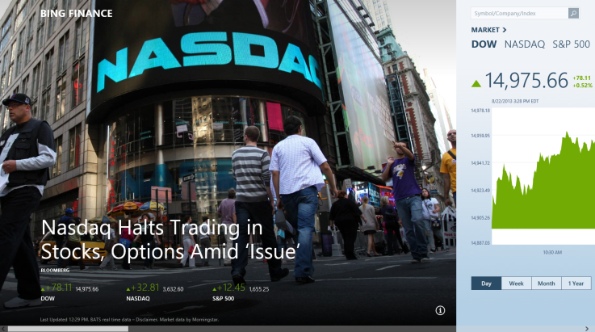
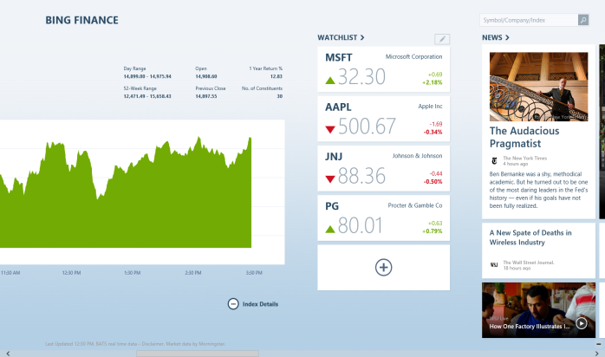
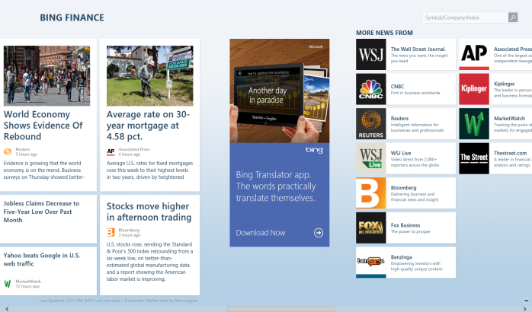
Bing Finance AiA Advertising
Impression Ads in the app
300x600 on main pano of Finance or Money
Ads within all Money articles
Users must be on W8.1 version
300x600
Here

Slide 59
Mobile Opportunities

Slide 60

Video Opportunity for Financial Services
27.5%
Of Microsoft Mobile users have household incomes of $100K or higher (124 index)
Activities of Microsoft’s mobile users
High ad recall
Index over 200 for recalling seeing mobile ads more than once monthly.
Buy on mobile
Index 325 for purchasing auto-related goods (including parts or service) on mobile.
Engaged with autos content More than 13 million access auto-related content on their mobile device at least monthly (Index 312)
44%
Female
56%
Male
25%
ages 25-34
(index 150 for this audience)
25%
are Hispanic
(index 170 for this audience)
1. comScore Mobilens, 3 month average, March 2013. Micorosft mobile properties include Skype, MSN, FoxSports, Telemundo. No audience filter applied.

Slide 61

Mobile Ad Inventory
Extensive app ecosystem via Zumobi
Large, integrated exclusive formats perform well above industry standards
Reach consumers on the go with an
extensive mobile ad network.
Visually beautiful,
easy to use apps

Slide 62
Finserv Mobile Inventory Opportunities
Reach an affluent & highly engaged audience at scale across Microsoft’s premium app network
Pair MSN mobile HP with MSN PC HP buys
Expand beyond MSN Money to a homepage buy that includes mobile homepage too
MSN homepage via mobile browse, so you capture traffic missed by native apps
App Network via Zumobi
Premium app ecosytem with target audiences that align with your customer segment
Mobile ad offerings across a trusted network of apps
Video Ad Network
Flexible sponsorship availability
Bundle with your MSN Money buy

Slide 63






































Premium App Ecosystem
Auto
Entertainment
50M
impressions
per category
Automobile
MSN Autos
MotorTrend
SN Nascar
Cars.com
Ology
TLC
Pandora
Access
Billboard
Hispanic
Men
Exclusive access to 33 premium
publishers
Delicioso
About.com
Televisión
Unavisión
Huff Post
MotorTrend
Xbox
PopSci
Men’s Fitness
Engadget
News
Sports
Brand safe mobile inventory with
incredible
consumer reach
The Week
NBC News
Fox News
Breaking News
CBS News
SN NFL
Ski & Snow Report
ESPN
Fox Sports
SN MLB
Women
Upscale
Celebrity Parade
Relish
Good Housekeeping
All Recipies
Cars.com
NBC News
Esquire
MSN Money
CNet
Dwell

Slide 64

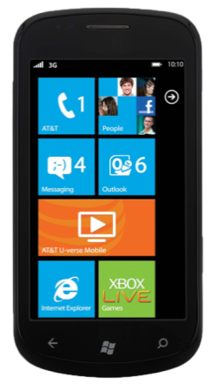
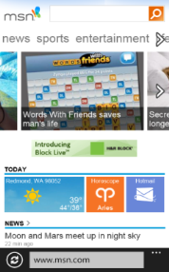
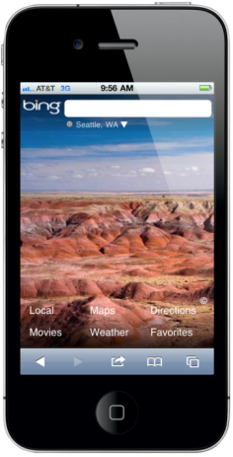
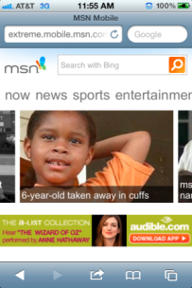
Own MSN mobile HP takeover for a day.
36M
Static
Banners
300X50
Unique Users²
2.2M
smartphone unique users per mo.¹
62%
male¹
600M+
Rich
Media
Expandable,
Full Screen Interstitial
Page views on MSN Mobile home page³
Our audience
skews 25-49¹
Source: 1. Mobile Metrix 2.0 Demographic Profile (18+), MSN Homepages, October 2012; 2. comScore MobiLens, (Feature and Smartphone), Microsoft Sites, US, October 2012 ; 3. MSN Trend Report, Jan. 2012

Slide 65
Custom Ad Opportunities
On Windows 8

Slide 66

Windows 8 - Gaining Momentum
100M
Windows 8 licenses sold
since launch
90k+
Apps since launch
250M
Apps downloaded since launch
“…it looks as if the Surface Pro is, conceptually and practically, a home run. For thousands of people, it will be an ideal mobile companion. It will mean the end of the daily question: “Hmm, should I take my laptop or my iPad?”
David Pogue, NY Times
2400+
certified devices for
Windows 8 and Windows RT
33%
agree that advertising on Windows 8 improves their opinion of a brand
Notes:
690MM Win7 devices can be upgraded. When you add in WinXP and Vista, then that number actually turns into 1.2 Billion. Huge opportunity!
100 million licenses of Windows 8 sold
Touch Matters – Windows 8 was being developed before the first iPad ever hit the shelves. We anticipated the importance of touch for consumers awhile ago and Windows 8 represents the culmination of that work.
Surpassed 250 million Store apps downloaded in the first six months - almost 90% of our app catalog has been downloaded every month
90k+ apps since launch. To give perspective, Apple after 15mos was at 10k apps.
This is a huge developer opportunity. In fact, in early in-placement creative testing with MetrixLab done in September 2012, looking at a mix of advertiser verticals across many modern UI apps
33% of users agreed Win 8 advertising helped improve their opinion of a brand compared to Portals (25%), Facebook (20%) and YouTube (18%)
CNET top 5 2013 - #4 Office 2013 (top 5 most viewed pages on CNET), #1 Surface Pro……. MSFT takes 2 slots (last year it was all apple in the 1 & 2 spots). This year there was no sign of Apple.
Number of certified devices for Windows 8 and Window RT grow to 2,400 devices (OEMs are now in full developmental cycles to create true touch enabled devices)
Aside from these early stats and positive press, it is important to understand the full potential:
Forrester predicts 200 million global information workers want a Windows tablet as their next work tablet (Mobile Workforce Adoption Trends, Forrester Research, Inc., February 4, 2013 )
Windows is, by far, the largest platform in the world. There are over a billion Window PCs in current use, including 690m Windows 7 devices as of March 2012.
In the last 2 years, there have been more Windows licenses sold than Android, iOS and Macs combined. And every Windows 7 PC can run Windows 8.
Along with these positive early stats around Win 8, our connected products perform great:
We have over 40 Million active Xbox LIVE users, we know that 46% of them explore advertising content on Xbox LIVE and 37% talk about brands seen on Xbox LIVE with many different people
Just before the end of 2012, the Windows Phone Store had added 75K new apps in 2012. Also, developer revenue has increased 40% since win phone 8 SDK released and now the win phone 8 is available in 191 markets (up from 35)
We have about 8 billion hours of calls per year in Skype – making this a very rich and personal type of engagement. When it comes to ad placement effectiveness, recent studies have shown that ads on Skype push the hardest-to-move metrics – the metrics at the bottom of the purchase funnel -- intent to recommend and intent to purchase. Ad exposure on Skype drives considerable lifts across the purchase journey: 15% in brand favorability, 17% in likelihood to recommend, 20% in advertising recall, 26% in intent to purchase, 59% in brand site visitation in the first two weeks following exposure to the ads versus those not exposed

Slide 67
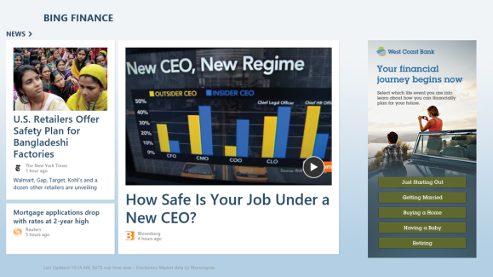
Custom Ad Opportunities (AiA)
Leverage W8 to create immersive brand experiences
Engage your target in ways you never imagined
Extend your brand message across multiple screens
Notes:
For consumers, Windows 8 seeks to unify all of your tasks and invite you in with its animated, live app tile design. Users come across your ad in an app and tap to open the experience
The live tile format brings fluidity and seamless content interaction to every device and channel. The live tile apps are immersive, filling the entire screen so there are no distractions. The live tiles work together, making it easy to search, share, and send content between them.

Slide 68

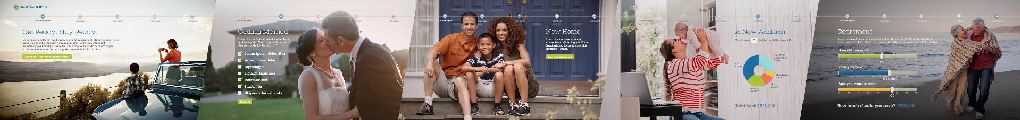

Windows 8 Ads in App
Notes:
For consumers, Windows 8 seeks to unify all of your tasks and invite you in with its animated, live app tile design.
The live tile format brings fluidity and seamless content interaction to every device and channel. The live tile apps are immersive, filling the entire screen so there are no distractions. The live tiles work together, making it easy to search, share, and send content between them.

Slide 69
Targeting

Slide 70
Finserv Targeting Opportunities
Experian
Mosaic Segmentation
Experian Mosaic segments cluster audiences by characteristics based on wealth of market research. They offer more detailed classifications vs. basic targeting, so you can engage the right audience
Demographics
Behaviors
Purchase choices and Intent
Lifestyle Choices
Recreational Activity
Investment behavior
Profile Targeting
Reach users based on key life events and behavioral choices
Occupation detail (Job Titles)
Median equivalency score
Education
Life Events – New Parents
Children in the HH by age range
Marital Status
New Movers
IXI – Financial & Wealth Targeting
Wealth Complete enables online marketers to target based on household-level total asset: Wealth and Total Deposits
Choose from 3 target segments based on estimated assets, that are further refined into 18 consumer groups based on age, behavior, and geography:
Mass Market - $0 -$100K
Mass Affluent $100K - $1M
Affluent - $1M+
Financial Cohorts Digital
Financial Cohorts Digital is an asset-based household segmentation system that segments households based on IXI’s proprietary measures of assets, total income, discretionary spending, and credit use. Clients use Financial Cohorts Digital to better understand the estimated financial and behavioral characteristics of households in their target clusters in order to increase the relevance and effectiveness of marketing efforts. There are 61 Financial Cohorts clusters.
Economic Cohorts Digital
Economic Cohorts Digital is an economic-based household segmentation system that segments households based on households’ economics, including estimates of total income, discretionary spending, and credit usage. Economic Cohorts’ 71 clusters allow marketers to better understand the economic and behavioral characteristics of households in their target clusters in order to increase the relevance and effectiveness of marketing efforts.
Experian
Mosaic Segmentation
Experian Mosaic segments cluster audiences by characteristics based on wealth of market research. They offer more detailed classifications vs. basic targeting, so you can engage
the right audience
IXI – Financial & Wealth Targeting
Wealth Complete enables online marketers to target based on household-level total asset:
Wealth and Total Deposits
Choose from 3 target segments based on estimated assets, that are further refined into
18 consumer groups based on age, behavior, and geography:
Mass Market - $0 -$100K
Mass Affluent $100K - $1M
Affluent - $1M+
Demographics
Behaviors
Purchase choices
and Intent
Lifestyle Choices
Recreational Activity
Investment behavior
Financial Cohorts Digital
Financial Cohorts Digital is an asset-based household segmentation system that segments households based on IXI’s proprietary measures of assets, total income, discretionary spending, and credit use. Clients use Financial Cohorts Digital to better understand the estimated financial and behavioral characteristics of households in their target clusters in order to increase the relevance and effectiveness of marketing efforts. There are 61 Financial Cohorts clusters.
Economic Cohorts Digital
Economic Cohorts Digital is an economic-based household segmentation system that segments households based on households’ economics, including estimates of total income, discretionary spending, and credit usage. Economic Cohorts’ 71 clusters allow marketers to better understand the economic and behavioral characteristics of households in their target clusters in order to increase the relevance and effectiveness of marketing efforts.
Profile Targeting
Reach users based on key life events and behavioral choices
Occupation detail
(Job Titles)
Median equivalency score
Education
Life Events – New Parents
Children in the HH
by age range
Marital Status
New Movers

Slide 71
More Targeting Options coming in early 2014
    Small Business Segments
    Small Business Assets Digital enables online marketers at financial institutions to target online visitors that are likely to be small business owners based on an estimate of the assets invested by small businesses, while maintaining user privacy. It is comprised of 6 categories that estimate small business assets up to $20M
    Discretionary Spending Dollars Digital
    Income data is often used by marketers to identify the spending capacity for a given household. But it neglects consumers’ financial commitments and ignores consumers’ discretionary spending. DS$ Digital is an estimate of a household’s spending after accounting for the fixed expenses of life (housing, utilities, public transportation, personal insurance and pensions). IXI’s discretionary spending estimates are organized in 9 differentiating ranges.
    Income 360
    Digital
    Income measures are pervasive but they are not all created equal. Income360 Digital provides a powerful estimate of your prospects’ and customers’ total household income, while maintaining user privacy. It estimates average household income in 11 ranges up to $250,000+. It is superior to other income measures because it factors in income generated from assets and is based on directly measured data rather than survey data.

Slide 72
Financial Service Targeting Segments
Standard BT (Behavioral Targeting) | Active Traders Auto Insurance Researchers Boat Insurance Researchers Credit Card Shoppers Credit Reporting Researchers | Expert Traders Health Insurance Researchers Home Buyers Home Refinancing and Home Equity Loan Researchers | Long Term Investors and Retirement Planners Mid/Large Business Decision Makers Motorcycle Insurance Researchers New Traders | Personal Banking Researchers Personal Investors Small Business Decision Makers Tax Preparers
Standard Profile Targeting | Income & Occupation Targeting
Experian Advanced Profile Targeting & Experian Mosaics | Occupation, Education Level, Behaviors, Investment Behavior
Precision Financial Segment Targets From IXI | 18 consumer groups based on estimated assets, income, spending, credit usage, and behavioral characteristics
Search Remessaging | Insert Financial Service Type Key works

Slide 73
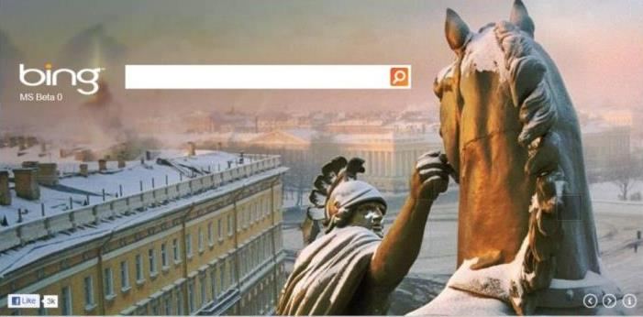
Why Bing search remessaging on the
Microsoft Media Network?
The power of search intent across high quality, brand safe content
Remessage to your users within 5 minutes of their search.
Target Search Keywords on Content for a fraction of Search CPCs
Bing Search Remessaging is the largest first party solution in market.
The Bing audience spends 18% more in online purchases than the average Internet user¹
comScore MediaMetrix, March 2013
Notes:
Bing targets “Information Seekers” and is positioned as a decision engine, offering innovative features and tools to help consumers make decisions faster and more efficiently, attracting users that are ready to buy – Quality, Reach, Efficiency
BPI: Bing 118, Google Search 120, Ask 117, Y! 117 – comScore March 2013

Slide 74
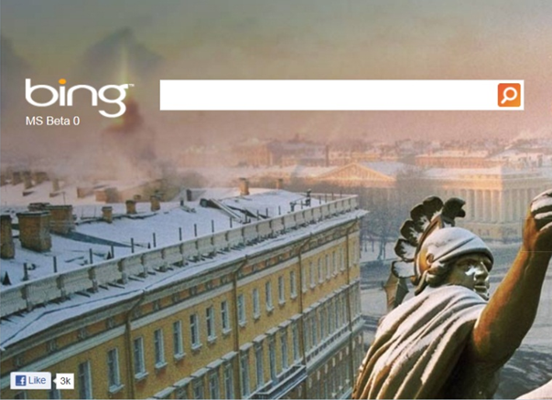
Bing and the finance industry, Your audience is...
142%
more likely to have applied for an education loan online in the last 6 months
37%
more likely to have applied for an IRA account online in the last 6 months
33%
more likely to have applied for an initial home mortgage online in the last 6 months
16%
more likely to have applied for Life Insurance online in the last 6 months
16%
more likely to have a primary residence valued at $1 million or more
15%
more likely to have applied for Life
Insurance online in the last 6 months
comScore Media Metrix, February 2013

Slide 75
Targeting

Slide 76
Banking & Lending

Slide 77

Banking services researchers on MSN are young & affluent; are prospective auto buyers
57%
Between the ages of 25-44
56%
Male
33%
Make more
than $100K
94%
Bought products & services online
24%
More likely to have 50-74 online brokerage transactions (higher than Yahoo! & Google)
22%
More likely to conduct research on the internet before making major online purchase (higher than Yahoo!, Google, AOL & Facebook)
36M banking services researchers online. Microsoft properties reach 84% of them
Source: comScore Plan Metrix May 2013 (Banking Services Researcher audience defined as those who have searched online for high yield saving accounts or CDs or checking account or initial/second home mortgages or savings account or credit cards in the last 6 months)

Slide 78
Banking Services researchers are on
Microsoft properties throughout the day
Morning
5-9am
Mid-Day
9am-1pm
Afternoon
1-5pm
Evening
5-8pm
Source: Microsoft Advertising Internal Reports for US, May 2013
Notes:
Morning (5-8am): 23%
of activity
Banking services researchers start their day on Microsoft properties with lifestyle content on Fitbie, Glo & Delish, catch up on finance content with MSN Money, on current affairs with MSN Now, MSN Homepage & MSN Local and updates on entertainment with MSN Entertainment.
Mid-day (9 am-12 pm): 28%
of activity
This audience continues to spend considerable amount of time on Microsoft properties like Fitbie, Glo, Delish, MSN Healthy Living, MSN Entertainment, MSN Now, MSN Local and MSN Living. MSN Homepage and MSN Money continue to be a focus area at this time.
Afternoon (1-4 pm): 23%
of activity
In the afternoon, activity on Microsoft properties is focused on MSN Autos, on lifestyle content on sites like MSN Healthy Living, MSN Living & Delish, on MSN Games, MSN News, Wonderwall, Skype, MSN Homepage, FoxSports and MSN Now.
Evening (5-8 pm): 15%
of activity
Evening is more for leisure and the banking services researcher audience site visits to MSN properties skews towards Skype, MSN Mobile, MSN Games, Windows Live, FoxSports, MSN Autos, MSN News, MSN Homepage and Wonderwall.

Slide 79
Banking Services consumers are engaged across MSN channels..
Banking audiences skew towards the MSN Homepage, Wonderwall, MSN Now, MSN Money and MSN Entertainment when compared to the general MSN audience
33%+ lift in numbers of users engaging in brand behavior
56%+ lift to homepages
post ad exposure
69% of the Banking audiences’ site visitation skews to MSN Homepage, Wonderwall, MSN Now and MSN Money

Slide 80
Banking and Lending: where to expand spend
Banking advertisers increased their focus spend on the MSN Homepage and MSN Money. Skype and Glo saw more investment from this advertising category in FY 2013
Source: Microsoft Advertising Internal Reports for US

Slide 81
Brokerage

Slide 82
Microsoft reaches all categories of brokerage audiences
6.6M Active Traders online. Microsoft properties reach 76% of them
57%
45+ age group
79%
Male
37%
Make more than $100K
92%
Shop online
8.2M New Traders online. Microsoft properties reach 76% of them
57%
25-54 age group
69%
Male
34%
Make more than $100K
90%
Bought products & services online
52.6M Long Term & Retirement Planners online. Microsoft properties reach 80% of them
72%
35+ age group
57%
Male
35%
Make more than $100K
93%
Shop online
Source: comScore Plan Metrix May 2013 (Active Traders defined as users with portfolio value>$500K or >50 brokerage transactions online); (New Traders defined as users who searched online for Money Market accounts, brokerage accounts, IRA or 401K in the last 6 months); (Long Term & Retirement planners defined as users who have IRA or 401K accounts)

Slide 83
Brokerage Audience are on
Microsoft properties throughout the day
Morning
5-9am
Mid-Day
9am-1pm
Afternoon
1-5pm
Evening
5-8pm
Source: Microsoft Advertising Internal Reports for US, May 2013
Notes:
Morning (5-8am): 24%
of activity
The brokerage audience starts their day on Microsoft properties with lifestyle content on Fitbie and Glo, catch up on current affairs with MSN Now, MSN Homepage & MSN Local, finance content on MSN Money, updates on entertainment with MSN Entertainment & Wonderwall
Mid-day (9 am-12 pm): 29%
of activity
This audience continues to spend considerable amount of time on Microsoft properties like Fitbie, Glo, Delish, MSN Money, MSN Healthy Living, MSN Entertainment, MSN Now, MSN Local, Wonderwall and MSN Homepage.
Afternoon (1-4 pm): 23%
of activity
In the afternoon, activity on Microsoft properties is focused on lifestyle content on sites like MSN Living, MSN Healthy Living & Delish, on MSN Autos, MSN Games, Skype, Wonderwall, MSN News, MSN Homepage, MSN Now and FoxSports
Evening (5-8 pm): 14%
of activity
Evening is more for leisure and the auto insurance researcher audience site visits to MSN properties skews towards Skype, MSN Mobile, Windows Live, MSN Games, MSN Autos & FoxSports. MSN News & MSN Homepage remains important during this time.

Slide 84
Brokerage consumers are engaged across MSN channels..
Brokerage audience skew towards the MSN Homepage, Wonderwall, MSN Money and MSN Autos when compared to the general MSN audience
97% lift in numbers of users engaging in brand behavior
171%+ lift to homepages
post ad exposure
69% of the Brokerage audiences’ site visitation is to MSN Homepage, Wonderwall and MSN Money

Slide 85
Brokerage: where to expand spend
Spend patterns are similar to last year with spend more focus on FoxSports, MSN Homepage and MSN Video
Source: Microsoft Advertising Internal Reports for US

Slide 86
Auto Insurance

Slide 87
Auto Insurance researchers on MSN are young & affluent; are prospective auto buyers
58%
Between the ages of 25-54
53%
Male
33%
Make more
than $100K
59%
Shop online for any product or service (research and/or buy online)
69%
More likely to buy a prestige luxury car in the next 6 months (higher than Yahoo!, Google, AOL, Facebook & YouTube)
67%
More likely to buy a compact sedan/coupe in the next 6 months (higher than Yahoo!, Google, AOL, Facebook & YouTube)
33M auto insurance researchers online. Microsoft properties reach 83% of them
Source: comScore Plan Metrix May 2013 (Auto Insurance Researcher audience defined as those who have searched for auto insurance online in the last 6 months)

Slide 88
Auto Insurance researchers are on
Microsoft properties throughout the day
Morning
5-9am
Mid-Day
9am-1pm
Afternoon
1-5pm
Evening
5-8pm
Source: Microsoft Advertising Internal Reports for US, May 2013
Notes:
Morning (5-8am): 24%
of activity
The brokerage audience starts their day on Microsoft properties with lifestyle content on Fitbie and Glo, catch up on current affairs with MSN Now, MSN Homepage & MSN Local, finance content on MSN Money, updates on entertainment with MSN Entertainment & Wonderwall
Mid-day (9 am-12 pm): 29%
of activity
This audience continues to spend considerable amount of time on Microsoft properties like Fitbie, Glo, Delish, MSN Money, MSN Healthy Living, MSN Entertainment, MSN Now, MSN Local, Wonderwall and MSN Homepage.
Afternoon (1-4 pm): 23%
of activity
In the afternoon, activity on Microsoft properties is focused on lifestyle content on sites like MSN Living, MSN Healthy Living & Delish, on MSN Autos, MSN Games, Skype, Wonderwall, MSN News, MSN Homepage, MSN Now and FoxSports
Evening (5-8 pm): 14%
of activity
Evening is more for leisure and the auto insurance researcher audience site visits to MSN properties skews towards Skype, MSN Mobile, Windows Live, MSN Games, MSN Autos & FoxSports. MSN News & MSN Homepage remains important during this time.

Slide 89
Find millions of auto insurance researchers on Microsoft properties, who cannot be found on competing sites
Microsoft sites reach
28M auto insurance researchers, most of these users are not duplicated on other finance sites.
11.3M
Not on AOL, Inc
10.7M
Not on Facebook
6.5M
Not on Yahoo!
2.1M
Not on Google
Source: comScore Plan Metrix, May 2013 (Auto Insurance Researcher audience defined as those who have searched for auto insurance online in the last 6 months)

Slide 90
Auto Insurance consumers are engaged across MSN channels.
Auto insurance researchers skew
towards the MSN Homepage, Wonderwall, MSN Money and MSN Autos when compared to the general MSN audience
54% lift in numbers of users engaging in brand behavior
171%+ lift to homepages
post ad exposure
63% of the Auto insurance researcher audience’ site visitation is to MSN Homepage, Wonderwall and MSN Money

Slide 91
Auto insurance: where to expand spend
Auto insurance advertisers increased their spend focus on Xbox Live, MSN Video, MSN Money and Wonderwall.
Source: Microsoft Advertising Internal Reports for US, May 2013

Slide 92
© 2013 Microsoft Corporation. All rights reserved. Microsoft, Windows, Windows Vista and other product names are or may be registered trademarks and/or trademarks in the U.S. and/or other countries.
The information herein is for informational purposes only and represents the current view of Microsoft Corporation as of the date of this presentation. Because Microsoft must respond to changing market conditions, it should not be interpreted to be a commitment on the part of Microsoft, and Microsoft cannot guarantee the accuracy of any information provided after the date of this presentation. MICROSOFT MAKES NO WARRANTIES, EXPRESS, IMPLIED OR STATUTORY, AS TO THE INFORMATION IN THIS PRESENTATION.

