Slide 1
Cross-Screen Engagement
65% say the only way they can get everything done is to multitask and use two or more devices at the same time.
Source: ‘Cross Screen Engagement,” Flamingo & Ipsos OTX, commissioned by Microsoft Advertising, November 2012 – February 2013. Qualitative study of USA, Australia, Brazil, Canada & UK conducted online and in personal interviews; Quantitative Sample = 1035 (USA)
Notes:
Multi-screen consumer behavior is changing. Our screens—televisions, computers, tablets, gaming consoles, e-readers and mobile phones—have become more powerful than the sum of their parts. The content we engage with on our devices, whether our intent is social, productive or entertaining in nature, helps us make sense of our lives, our communities and even ourselves.
In fact, in our custom survey, 65% say the only way they can get everything done is to multi-task and use two or more devices at the same time*
*Source: % of consumer who agree* strongly agree or somewhat agree. ‘Cross Screen Engagement,” Flamingo & Ipsos OTX, commissioned by Microsoft Advertising, November 2012 – February 2013. Qualitative study of USA, Australia, Brazil, Canada & UK conducted online and in personal interviews; Quantitative Sample = 1035 (USA)

Slide 2
People ‘multi-screen’ and are open to seeing ads!
74%
87%
of consumers agree that “Advertising can be helpful in telling me about new products or brands that might interest me.”
of consumers agree that “It’s great that I can check out products or brands that interest me whenever or wherever I see them.”
82%
73%
of global consumers surveyed say that multi-screening makes them more efficient.
agree that they like when companies provide useful apps that help them organize their lives or carry out tasks.
Multi-tasking and distraction
Investigation and discovery
Connection and sharing
Intent- and task-based
Notes:
The great news for marketers is that consumers are still receptive to advertising despite their attention being more divided across screens [READ STATS]
Our study shows as long as there is value in the experience, multi-screening consumers are open to ads. But the openness varies depending on how and where the content is delivered.
Apps are helping to facilitate efficiency and are making the commercial content experiences more relevant for consumers to help drive efficiency in our daily lives.

Slide 3

Agenda
Key Insights
What’s
behind our multi-screening
Digging Deeper into the Paths
Behavior:
What does this mean for marketers?
How Microsoft
can help
Notes:
Our new Cross-Screen Engagement research digs into the evolution of multi-screen engagement, revealing four common multi-screen pathways. We’ll dive into each of the pathways and show how understanding the motivations behind these behaviors and leveraging the MSA ecosystem can help marketers gain a digital advantage through authentic interaction with customers under a new set of ‘always-on’ rules.
The Approach & Methodology
We’re defining ‘multi-screening’ as using one or more screens in varying combinations to accomplish a task.To uncover new insights around multi-screen behavior, we took a two-phased approach. For the qualitative discovery phase, we interviewed early adopters in big city markets. For the quantitative phase, we validated our qualitative patterns using market-representative panels.
Qualitative
We partnered with Flamingo Research to recruit consumers ages 18-54 who owned multiple devices (a mix of smartphones, tablets, e-readers, gaming consoles and laptops) and used a second screen on a daily basis. They participated in 8 digital diaries for 5 days across large cities in 5 markets: Sydney, Australia, Sao Paulo, Brazil, Toronto, Canada, London, UK and Chicago, USA. The four most compelling respondents in each market also participated in in-home ethnographies. Finally, we conducted 2 “leading edge” group interviews in the US, UK and Brazil for consumers ages 26-35 and 36-50 in order to establish super users whose behavior and motivations would indicate future adoption.
Quantitative
The quantitative portion of the study included approximately 1000 consumers ages 18-65 in the US and UK respectively, as well as approximately 500 consumers in Brazil, Australia and Canada for a total of 3586 consumers globally. We partnered with Ipsos OTX to use a representative market sample via panel and required that consumers own a representative mix of devices (smartphones, tablets, gaming consoles and laptops). We analyzed the results throughout February 2013.

Slide 4
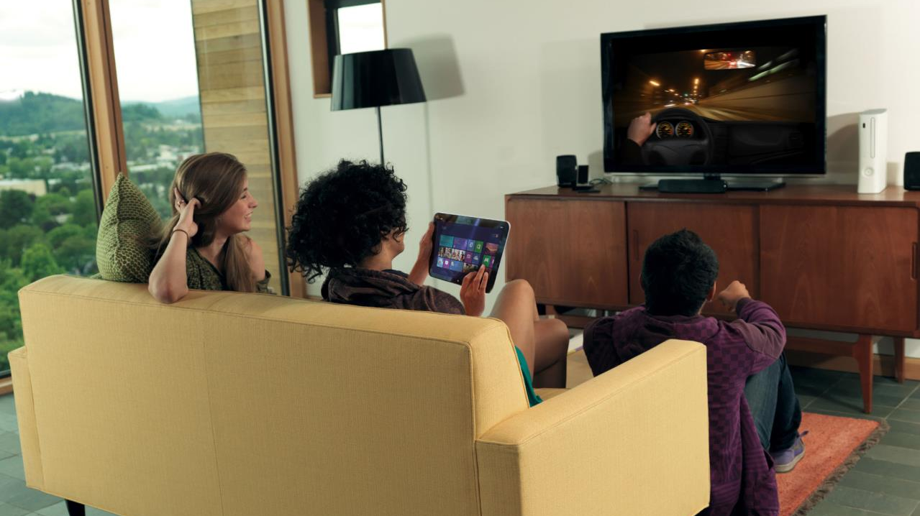

From Primetime
to 'Always On' Screen Time
7in 10
consumers use a second device in some capacity while watching TV.
Source: ‘Cross Screen Engagement,” Flamingo & Ipsos OTX, commissioned by Microsoft Advertising, November 2012 – February 2013. Qualitative, study of USA, Australia, Brazil, Canada & UK conducted online and in personal interviews; Quantitative Sample = 499 (Australia), 545 (Brazil), 505 (Canada); 1035 (USA)
Notes:
Consumers now control their own ‘flow’ of content all day, half the night and from screens large and small. Where content was once king, we now believe User Experience toppled content’s reign: the ease with which consumers can use a device at any given time is just as important as the content that’s enabled through the device.
Consumers pull what they want – marketers can no longer rely on push

Slide 5

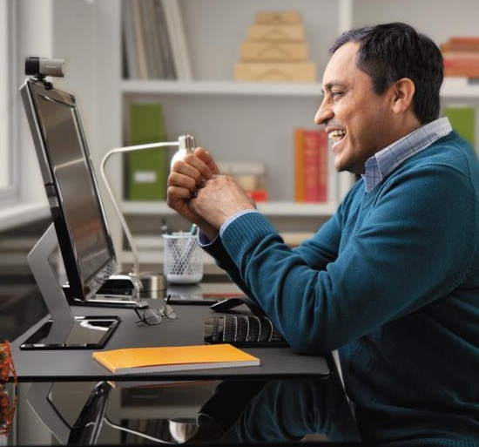

Mobile is the most traveled,
Tablet is the most social
PC is still the
center of it all.
69%
of multi-screen interactions still involve the PC.
Source: ‘Cross Screen Engagement,” Flamingo & Ipsos OTX, commissioned by Microsoft Advertising, November 2012 – February 2013.)
Notes:
While mobile phones are the most traveled and tablets are the most social devices, the PC is still at the center of our lives and does the heavy lifting. TV+ PC is still the most popular multi-screen combination according to our study.
The most popular screen combinations include: TV + PC (44%), PC + Phone (25%) and TV + Phone (23%).
Screen ownership in the US (Source: IPSOS Qualitative Cross-Screen Engagement study, 2012/2013)
Television 90%
Desktop Computer 69%
Laptop Computer 81%
Tablet 50%
Smartphone 77%
eReader 30%
Gaming Console 64%

Slide 6


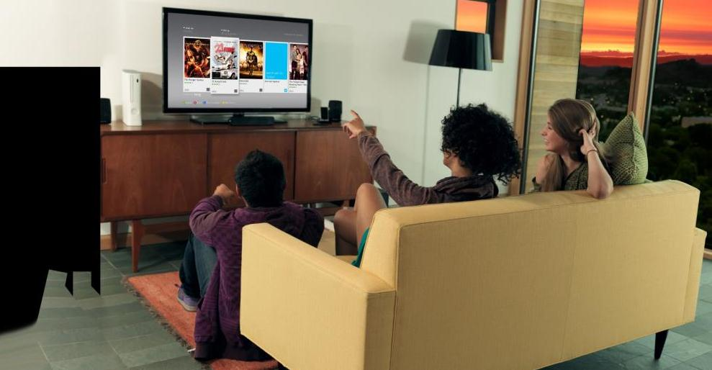
Time of Day Matters
Evening
Mid-Day
Task-based mixed with
Social/enjoyment
Relaxation
Social/Enjoyment
Morning
Task-based
Practical activities
Notes:
We also uncovered some interesting research around dayparts. While consumers are connected for nearly all their waking hours, mornings tend to be reserved for task-based and practical activities, while evenings are more reflexive, emotive and open. Marketers should tailor their messaging throughout the day, while shifting from traditional ‘primetime’ moments to meeting consumers in their moment.
Mornings (9a-12p): Mobile, PC, Tablet Consumers are in a more single task mindset, planning for their day
Mobile, especially is the key screen in the early morning (6a-9a) timeframe.
PC, Tablet becomes more dominant as the workday gets into full swing. TV and Gaming Console could be in the background for home-based task activities during on the weekend.
Mid-day (12-3p) PC, Gaming Console
No surprise PC is still the primary screen during the workday, but our research also shows gaming peaks slightly during this timeframe before the evening.
Social activity with PC also Mobile and Tablet are important during this timeframe to help stay connected, enhance enjoyment and travel where PC can’t.
Evening (6-9p) Mobile, TV, Tablet Multi-screening kicks into high gear
Usage for all screens peaks during the after work/prime time hours. Mobile (42%), TV (40%) and Tablet (36%); however the Gaming Console and PC also reports the highest usage during this daypart but more to a lesser degree (32% and 34% respectively).
Source: ‘Cross Screen Engagement,” Flamingo & Ipsos OTX, commissioned by Microsoft Advertising, November 2012 – February 2013.
Qualitative, study of USA, Australia, Brazil, Canada & UK conducted online and in personal interviews; Quantitative Sample = 499 (Australia), 545 (Brazil), 505 (Canada); 1035 (USA

Slide 7
What’s behind our
Multi-screening Behavior

Slide 8
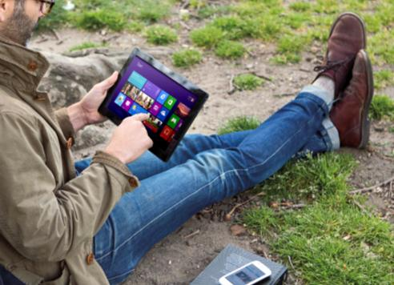

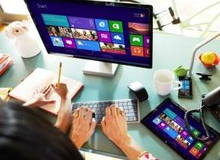

Four Types of Multi-screen Behavior
Content Grazing
Investigative
Spider-Webbing
Social
Spider-Webbing
Quantum Journeys
71%
57%
38%
41%
Source: ‘Cross Screen Engagement,” Flamingo & Ipsos OTX, commissioned Qualitative, study of USA, Australia, Brazil, Canada & UK conducted online and in personal interviews; Quantitative Sample = 1035 (USA)
Notes:
Like people, screens merge, separate and recombine in varying combinations. Identifying these patterns and the need-states that motivate them can help marketers simplify their approach to consumer engagement. As these pathways and new day-parts become more mainstream, marketers will find limited success simply pushing out campaigns in traditional methods; they must engage their customers during key moments of interaction, rather than during conventional time slots.
Four pathways of multi-screening behavior exist, with four distinct motivations behind each:
Content Grazing – multitasking on 2 or more devices at once
o 71% engage in content-grazing (% of US multi-screening respondents)
o Tends to be the most common and habit-forming pathway –“single screen annoys me…I always try and have two screens going.”
Investigative Spider-Webbing – consumers view related content on 2 or more devices at same time
o 57% spider-web with an investigative intent (*% of US multi-screening respondents)
o 2nd most common multi-screening behavior after Content Grazing
Social Spider-Webbing – consumers focus on sharing/connecting content they find with others via another device
o 39% spider-web with a sharing and connecting intent (*% of US multi-screening respondents)
o 1 in 5 consumers engage in social spider-webbing pathways while watching live TV.
Quantum Journeys – consumers start an activity on one screen and continue it on another
o 41% of consumers take quantum journeys
o Efficiency and productivity are paramount –“there is usually a reason I go on [my laptop] either something captures me to purchase later or interests me to go more in depth.”

Slide 9
Digging Deeper into the Paths

Slide 10
Content Grazing
“Single screen annoys me…I always try to have two screens going.”
– Super User Group, US
Notes:
The first is a separate pathway we call Content Grazing, where different content is consumed on 2 or more devices simultaneously. TV + PC is the most common screen combination.
While consumers tend to think of this behavior as “multi-tasking,” we found that it tends to be the most common and habit-forming pathway, and likely closer to distraction behavior. In our custom study, 64% of consumers find it hard to spend 2 hours watching TV or a movie without using their laptop, picking up their phone or tablet at least once or twice (Source: IPSOS Qualitative Research, 2012)
The challenge for marketers is in inserting themselves into a moment of distraction, either providing a quick game or snippet of content that satisfies this need for a quite bit of distraction or attempting to overcome short-attention spans and encourage deeper engagement.
Microsoft Solution
Quick bites of contextual, commercial content embedded in Windows 8 Ads in Apps provide fast, fun engagement for short attention spans. And in fact, scores for
ad recall for the Windows 8 Ads in Apps pilot program outperformed the benchmark for microsite evaluation at a 92% rate of recall.*
*Windows 8 Ads in Apps RP Pilot Research, September 2012

Slide 11
Investigative Spider-Webbing
“Now I don’t want to watch TV by itself; there is just a lot more that entertains me. I find that there is time when I am relaxing, to find out more, to do it all—because it interests me so much.”
-Super User Group, US
Notes:
The second and third is what we called Spider-Webbing, where consumers engage with related content on two or more screens simultaneously. The most common screen combination here is TV + PC. Again, the PC is one of the primary screens .
In this pathway, 57% of consumers journey around content and is the 2nd most common multi-screen behavior, behind Content Grazing. This is where consumers view related content on two or more devices at the same time. This is a curiosity-led and slightly introverted moment of deep engagement, where consumers seek information or content that complements and amplifies the primary screen.
Consumers may face frustrations if they can’t find compelling enough supplementary content and subsequently abandon even the original activity. There’s an opportunity for marketers to distribute content thoughtfully, dispersing it along exploratory threads to encourage deeper exploration and satisfy the consumers’ need to search and find more. Entertainment, bonus rewards for seeking more are the payoff.
[Example: Johnny watches his favorite rugby match on the Xbox ESPN app television, while checking stats and looking up players on his Win8 Surface tablet.]
Microsoft solution:
Windows 8 is the ultimate Spider-webbing enabler. Connect an Xbox streaming experience to tablet’s exploration mode using SmartGlass, which enables devices to work together to show rich, interactive activities and new content.

Slide 12
Social Spider-Webbing
“You’re in touch with a lot more stuff – like if I’m watching TV and I want to tell someone about it: I can contact anyone around the world at any time.”
-Super User Group, US
Notes:
In the Social Spider-Webbing pathway, this involves transferring the experience with your primary screen into a more enjoyable, shared one. The commentary is just as important as the content here. TV + PC, PC +Mobile are the top multi-screen combinations.
This at the polar end of Investigative Spider-Webbing despite the similar web-like pattern; it’s extroverted, and focused on sharing and connecting. The need to connect to like-minded communities and add to the conversation drives this multi-screening behavior. A potential drawback is that brands still face challenges integrating with socially-generated content, but the opportunity to target audiences where they are likely to interact deeply and emotionally with the community is compelling.
[Example: Ann watches election coverage on her surface, while tweeting and checking Facebook on her mobile]
Microsoft solution:
Skype helps you tell your brand story at scale and on the platform that consumers prefer: across PCs, TVs and mobile devices. Connect through rich,
engaging ad experiences in environments where consumers make more personal social connections.
Xbox NUads make TV more engaging through interactive polling experiences that allow brands to connect instantly with consumers.

Slide 13
Quantum Journey
“There is usually a reason I go on [my laptop] either something captures me to purchase later or interests me to go more in depth.”
-Super User Group, US
Notes:
The last pathway is called Quantum, the same related journey over time, where consumers start an activity on one screen and complete it on another. Quantum journeys are all about efficiency. Consumers leap over time, space and screen to due to location or ease-of-use. This pathway is distinctly intent-based, and as a result, efficiency and productivity is paramount.
While consumers expect consistent, cohesive experiences, the technology is often still not seamless. Quantum journeys can often be chaotic and disjointed. Marketers should seek out partners who can help deliver seamless experiences, where they can seed ideas on one screen for further exploration on another, and then encourage consumers to move to the screen that best suits their goal.
[Example: snapping picture of a pair of shoes you see on your mobile phone while window shopping. When you get home, you get on your laptop to learn more or buy the shoes.]
Microsoft Solution
Windows 8’s consistent UI provides a unified user experience across PCs, tablets, mobile phones and Xbox gaming consoles. Easy access to cloud-based efficiency tools such as Outlook.com and Sky Drive make moving from work to home —while getting things done—simple and seamless.

Slide 14
What does this mean for marketers?

Slide 15


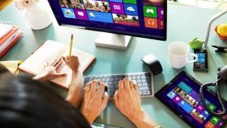

Consumer intent drives interaction and engagement
Content Grazing
Keep it bite-sized, fun and entertaining
Engagement is fast – consumers won’t
hang long
Investigative Spider-webbing:
Provide an appetite for supplemental info.
Leave a ‘content’ trail for consumers to explore
Social
Spider-webbing:
Facilitate social interaction through conversation
Weave your own social threads for consumers
to explore
Quantum
Journeys
Leverage connected devices
Add value as the consumer adds screens (i.e. a mobile coupon to cash in on a PC)
Notes:
How can marketers act on these insights?
While consumers are Content Grazing:
o Keep it bite-sized, fun, quick and efficient
o Understand the measurement implications: consumers may not want to hang around, so dwell time and other engagement metrics likely won’t be effective here
While consumers are Investigative Spider-webbing:
o Pique curiosity and provide an appetite for supplemental information
o Curate content and leave a compelling trail for consumers to explore
While consumers are Social Spider-Webbing:
o Facilitate social interaction through conversation
o Weave your own social threads for consumers to explore; keep it valuable and interactive
While consumers are Quantum Leaping:
o Keep it simple and seamless; leverage connected devices to move the consumer to the best screen for your goal
o Add value to the experience as the consumer adds incremental screens, i.e., deliver mobile coupons that can easily be utilized via the cloud and ‘cashed in’ on computers

Slide 16
How can Microsoft help?

Slide 17
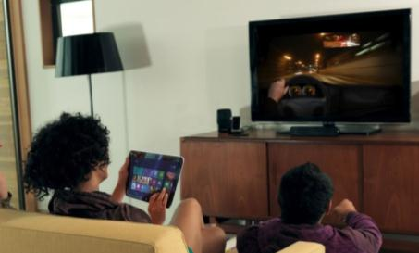
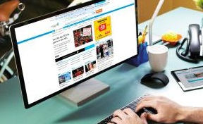

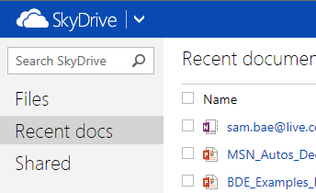






We can Facilitate Seamless Connections
Content Grazing
Investigative
Spider-webbing:
Social
Spider-webbing:
Quantum Journeys
Xbox SmartGlass
Notes:
CONTENT GRAZING
TV + PC/laptop
Quick bites of content via Xbox and Bing apps in Windows 8 provide fast, fun engagement for short attention spans. And in fact, scores for ad recall for the Windows 8 Ads in Apps pilot program outperform the benchmark for microsite evaluation at a 92% rate of recall.
SPIDER-WEBBING INVESTIGATIVE
TV + PC/laptop
Windows 8 is the ultimate spider-webbing enabler. Spark a Spider-Webbing pathway by connecting an Xbox streaming experience to tablet’s exploration mode using SmartGlass, which enables devices to work together to show rich interactive activities and new content
SPIDER-WEBBING SOCIAL
TV + PC, PC+ Mobile
Skype is a powerhouse Social Spider-Webbing tool. Utilize Skype’s broad social platforms in conversational spaces. Consider hosting branded Skype chat sessions during popular live events.
Xbox Nuads enable social sharing features that help launch a social spider-webbing journey
QUANTUM
Mobile + PC
Windows 8’s consistent UI provides a unified user experience across PCs, tablets, mobile phones and the Xbox gaming consoles. Easy access to cloud-based efficiency tools such as SkyDrive & Outlook.com make moving from work to home while getting things done simple and seamless.

Slide 18



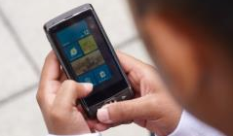
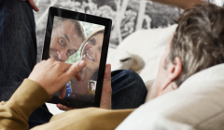
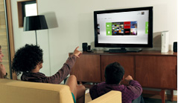
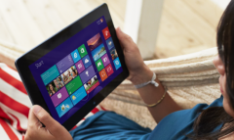
We can reach your audience across screens
Windows 8
Mobile
Xbox Live
Tablet
Mobile
Skype
More than 1,700 Windows 8
certified devices and growing
72% agree apps help them get what they want from the internet more quickly
Over 30 minutes in time spent
More than 100M Windows 8 apps downloaded
More than 100M Windows 8 apps downloaded
Sources: 3. Pew Research Center’ Oct. 2012 ; IPSOS OTX Microsoft Advertising Custom Study 4. A18+ log into Xbox Kinect 1+/month; Simmons Spring 2012
Notes:
Windows 8’s consistent UI provides a unified, relevant user experience across PCs, tablets, mobile phones and Xbox gaming consoles.
PC: Desktop/Laptop
The PC is still the sage and trusted companion for deeper information. Rich content on Microsoft sites, MSN Video and Ads in Apps for Windows 8 have the depth and breadth to bring you closer to your audience at each of the multiscreen pathways
Mobile
The mobile phone is the bridge between at work, on-the-go and home; Microsoft’s mobile network, Ads in Apps for Windows 8 and targeting features can drive relevance.
Skype: [READ STAT] Spark social connections across screens
13M unique users daily; 16% growth in US YoY (Source: Internal data dec ’11 vs ’12)
Skype offers ad experiences tailored to PC and mobile so you can connect with your audience throughout the day.
Ads on Skype are seen as more trustworthy and relevant than Facebook, Twitter, Yahoo! And YouTube.** Users feel Skype is a more personal experience than Facebook or Twitter.**
They’re also multi-tasking. The top three search activities Skype users are doing while on Skype are shopping, entertainment and social (MSFT Advertising Reports, 11/2012)
**Skype user research, July 2012, conducted by Ipsos MediaCT on behalf of Microsoft
Xbox Entertain and drive social experiences throughout the day [READ STATS]
**34% often access social sites across devices
**Source: Simmons Spring 2012 Release

Slide 19
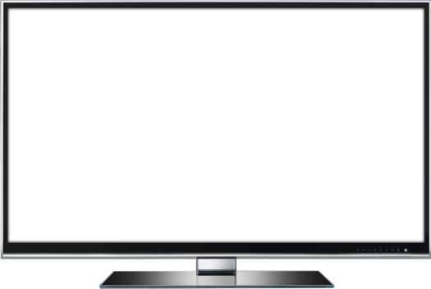
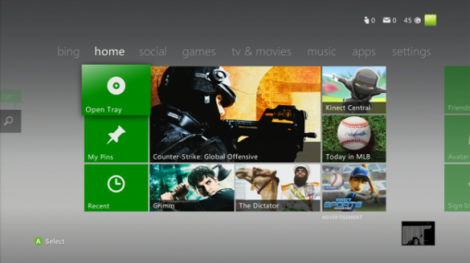
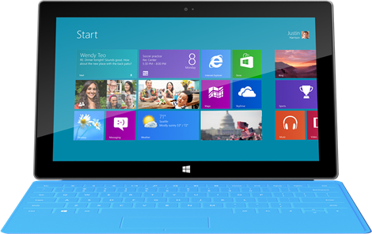
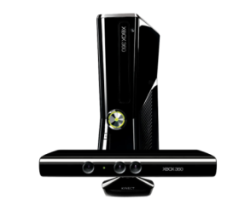
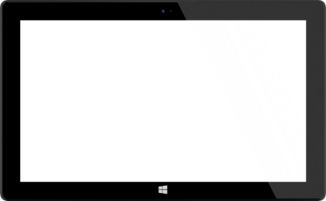
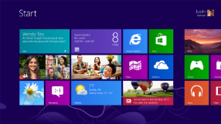
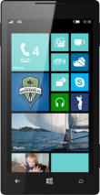
Unified by design, connected to each other.
Notes:
The unique Windows 8 tile design will eventually exist in every technology and device Microsoft brings to the marketplace, linking them seamlessly for consistent content experiences.
Microsoft is the first company to ever offer this type of experience. We’re going to market with a full ecosystem of products – from the tablet, to the PC, to the phone, Bing, Xbox, Skype and MSN. When Microsoft puts the consumer first, amazing things happen for brands and advertisers. It means that the brand experience across screens is more engaging, immersive and innovative than ever before. No other company has that kind of breadth to connect brands.
What does it mean for advertisers?
Creates completely new ad models and experiences that leverage the unique and native capabilities of the platforms they are on. Experiences that respect the consumer and enhance their user experience rather than detract. More receptive consumers = more effective advertising.
We can build brand experiences across people’s personal devices enabling consumers to interact with advertising content and apps from whatever device they are on in a simple and engaging way.
We can provide engaging experiences that are contextually relevant to consumers. Ads inside of the apps make sense to the user and are relevant to what the user came to the app to do – so they are able to explore and discover ads without disrupting their experience.

Slide 20

© 2013 Microsoft Corporation. All rights reserved. Microsoft, Windows, Windows Vista and other product names are or may be registered trademarks and/or trademarks in the U.S. and/or other countries.
The information herein is for informational purposes only and represents the current view of Microsoft Corporation as of the date of this presentation. Because Microsoft must respond to changing market conditions, it should not be interpreted to be a commitment on the part of Microsoft, and Microsoft cannot guarantee the accuracy of any information provided after the date of this presentation. MICROSOFT MAKES NO WARRANTIES, EXPRESS, IMPLIED OR STATUTORY, AS TO THE INFORMATION IN THIS PRESENTATION.
Notes:
© 2013 Microsoft Corporation. All rights reserved. Microsoft, Windows, and other product names are or may be registered trademarks and/or trademarks in the U.S. and/or other countries.
The information herein is for informational purposes only and represents the current view of Microsoft Corporation as of the date of this presentation. Because Microsoft must respond to changing market conditions, it should not be interpreted to be a commitment on the part of Microsoft, and Microsoft cannot guarantee the accuracy of any information provided after the date of this presentation. MICROSOFT MAKES NO WARRANTIES, EXPRESS, IMPLIED OR STATUTORY, AS TO THE INFORMATION IN THIS PRESENTATION.

